Slide 1
Case Study 4: Oil and Gas Asset Management Analysis
Batch1_Sitesh_muduli
Batch1_Soumya_Sourav_behera
Batch5_arohi_rathore
Batch5_Annika_Chandra
Batch5_Shashikant_suman

Slide 2
Problem Statement
In the dynamic landscape of the global upstream oil and gas industry, understanding the historical trends and future projections is essential for informed decision-making and strategic planning.
The goal is to uncover insights that can drive macro analyses, inform market strategies, aid in company valuation, facilitate business development, and shed light on the oil service industry's market dynamics

Slide 3
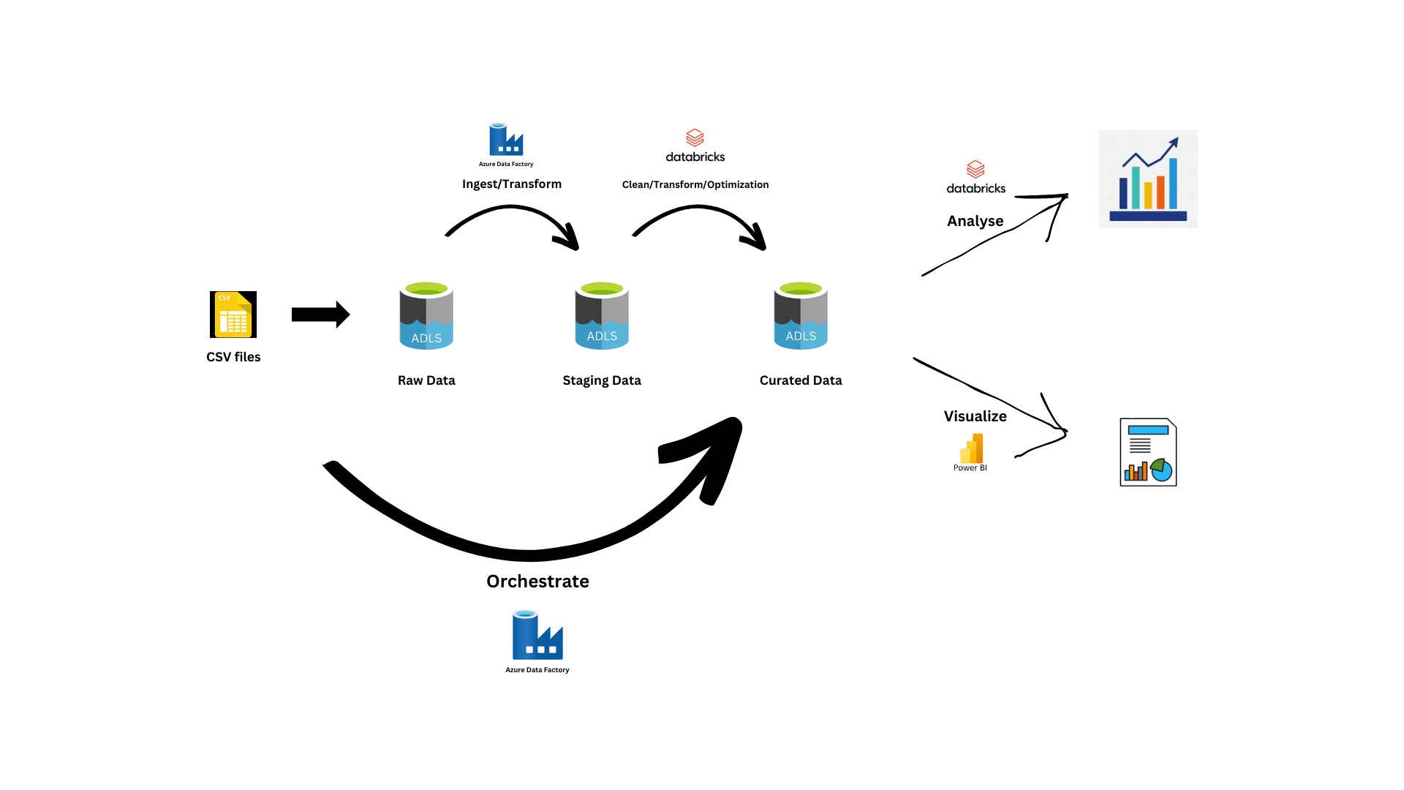
Data Flow Architecture

Slide 4
Snapshots of development of each layer

Slide 5
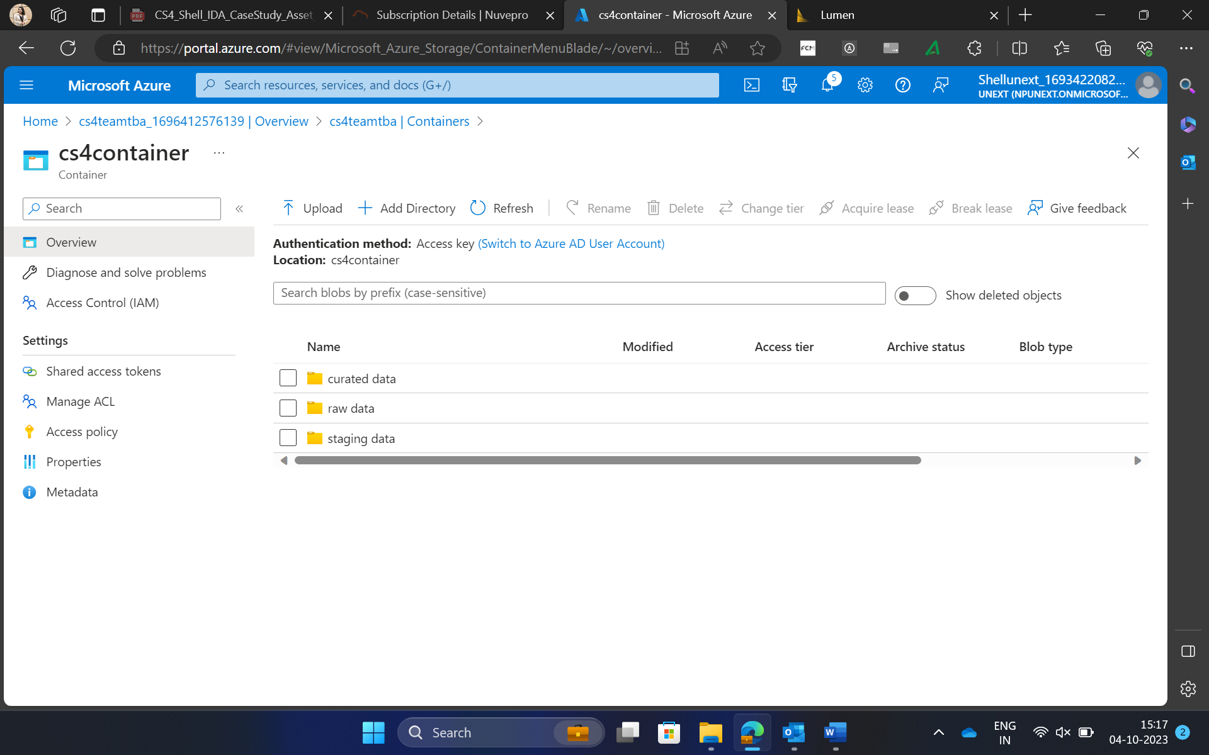
Raw Layer

Slide 6
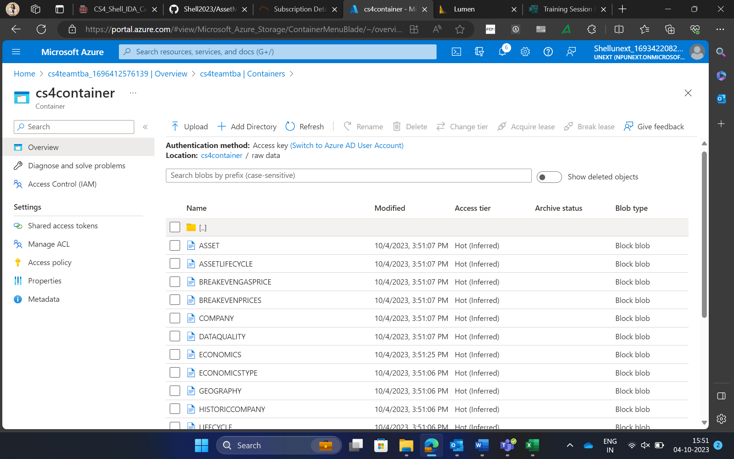
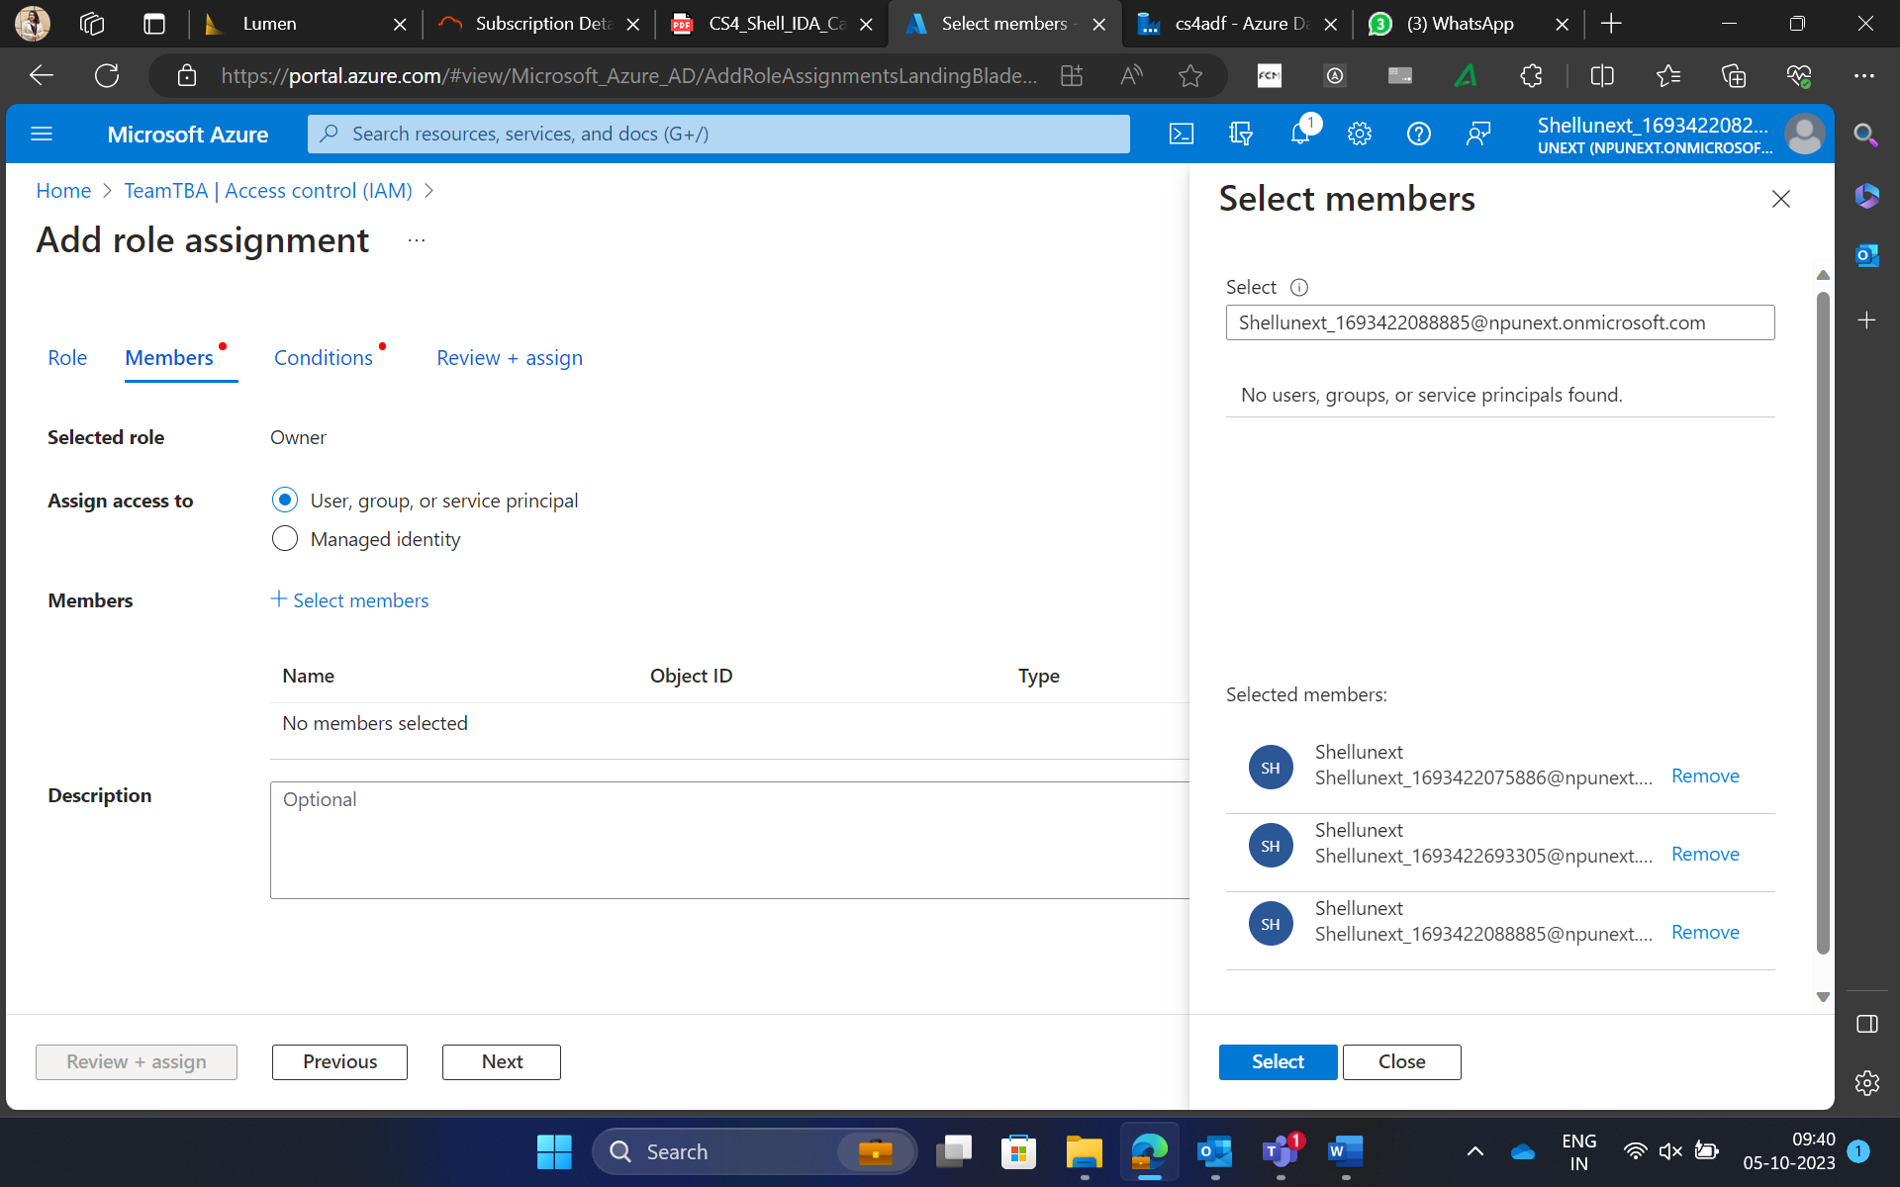
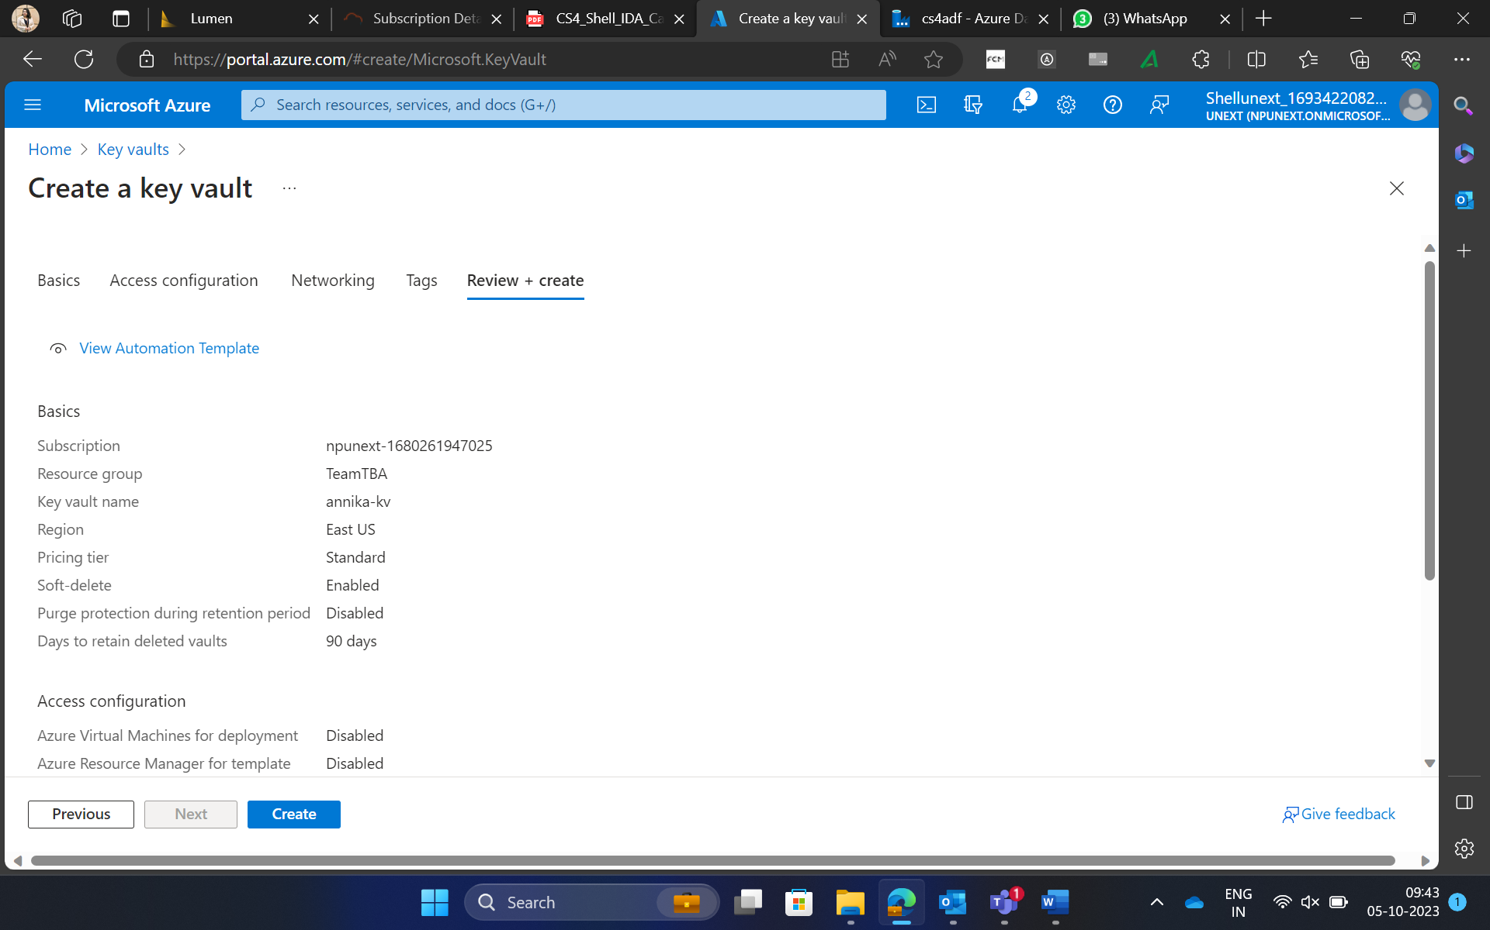

Slide 7
Staging Layer

Slide 8
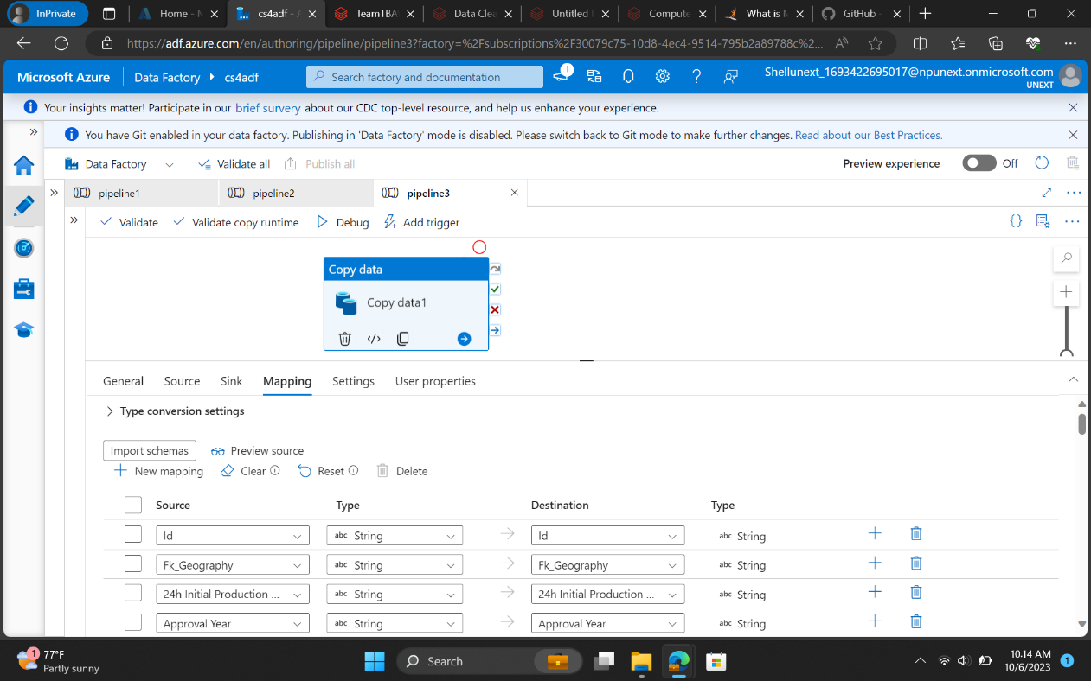
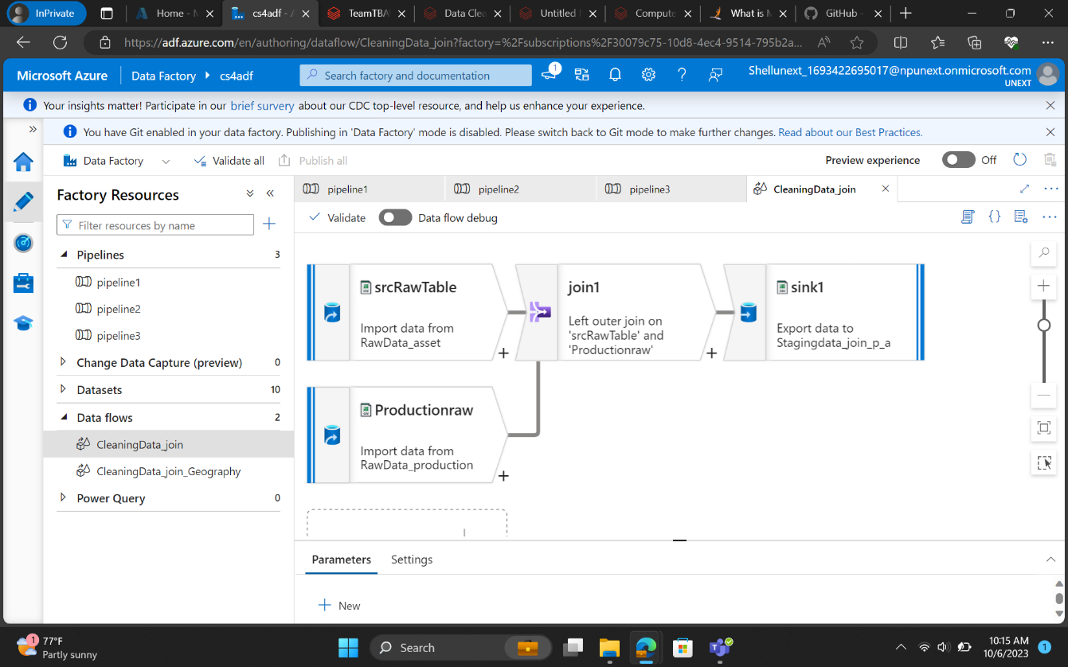

Slide 9
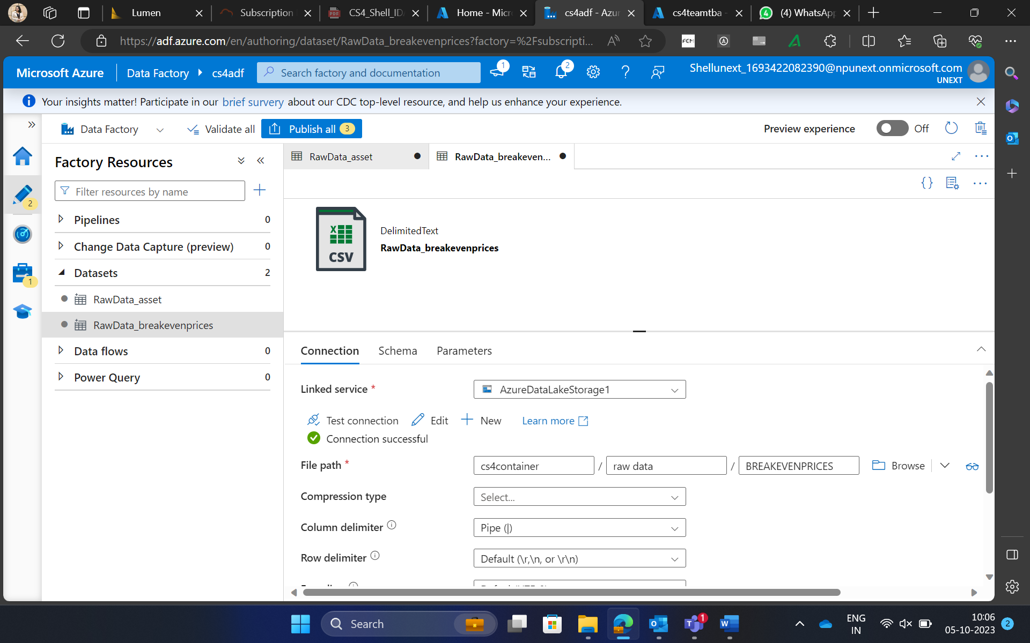
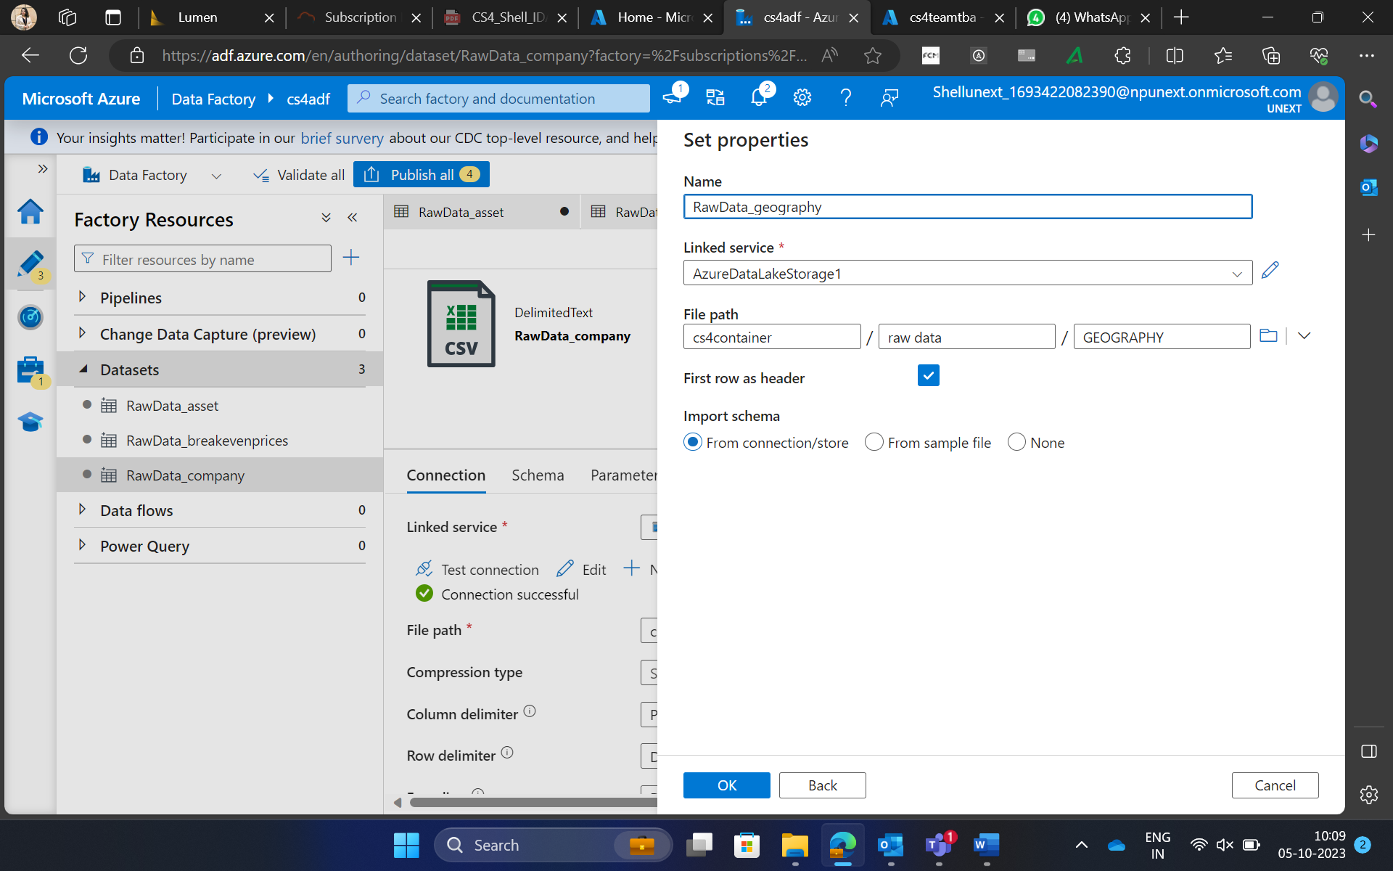
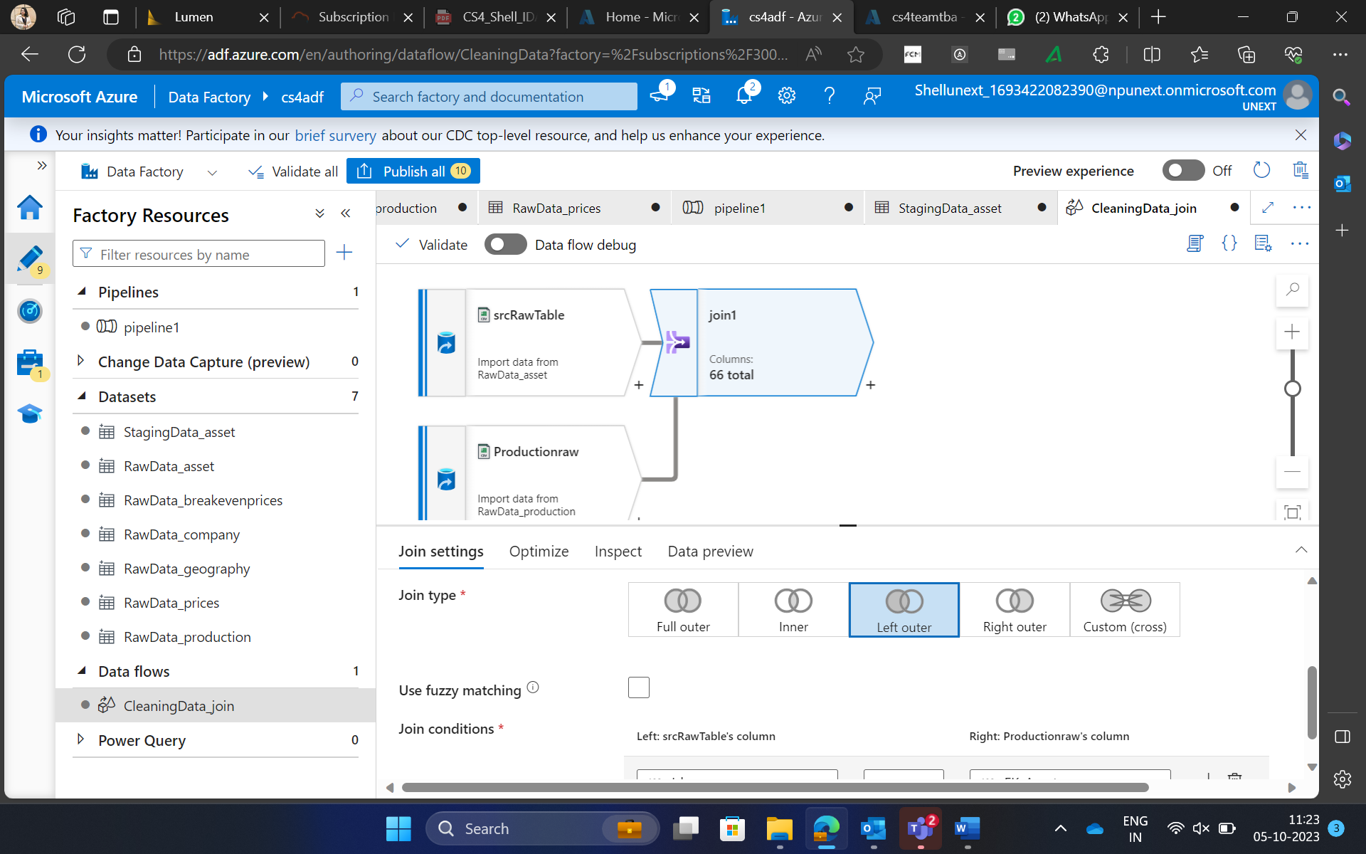

Slide 10
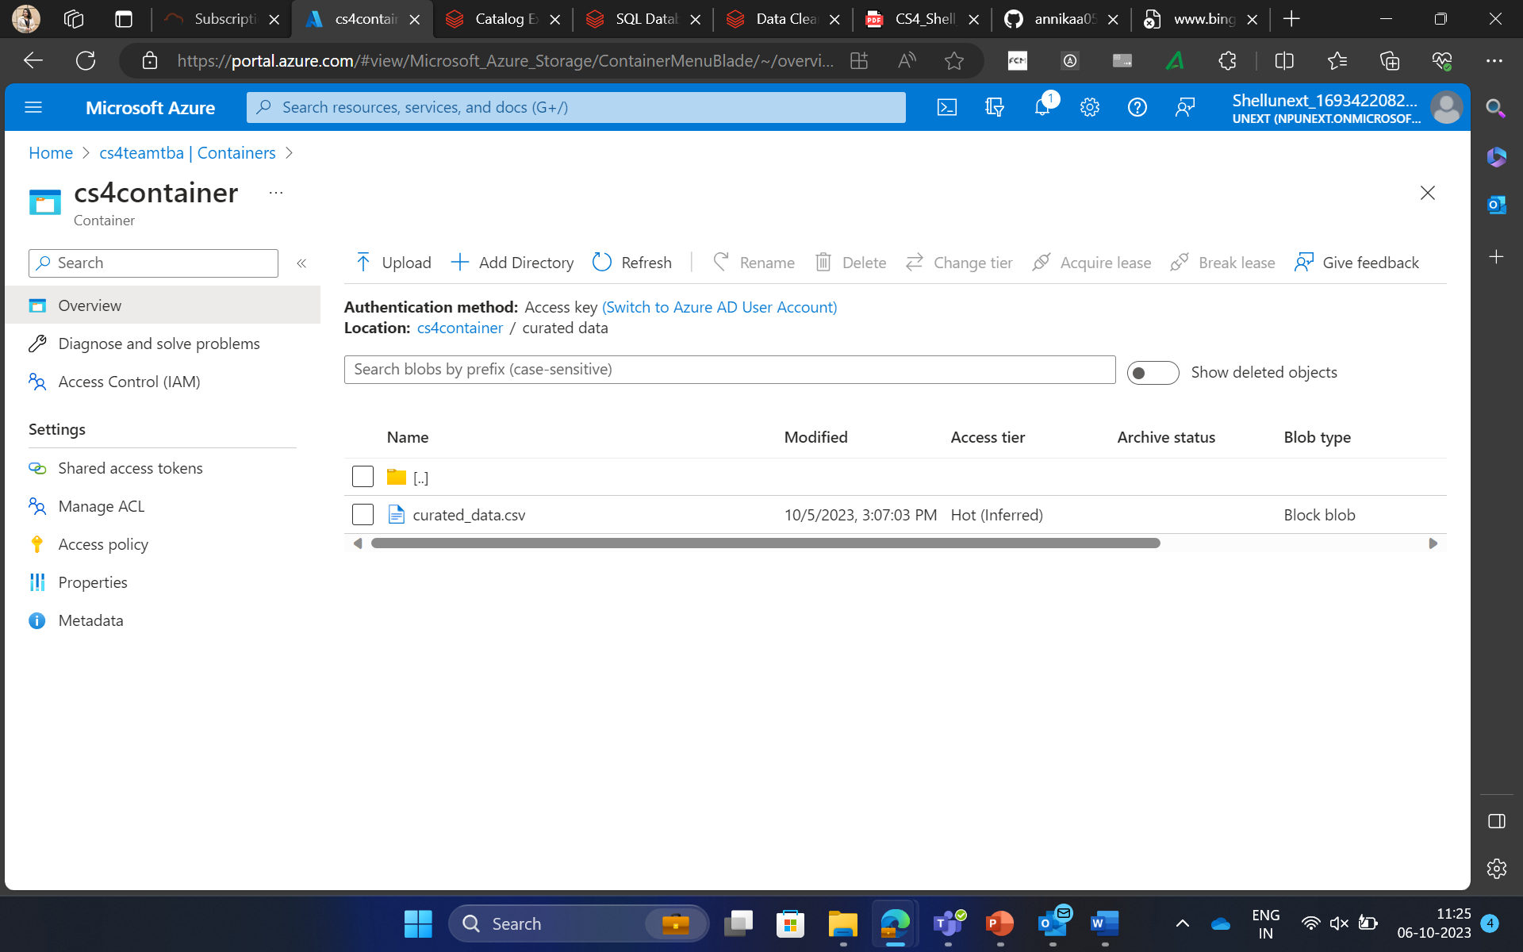
Curated Layer

Slide 11
Screenshots of Dashboards

Slide 12
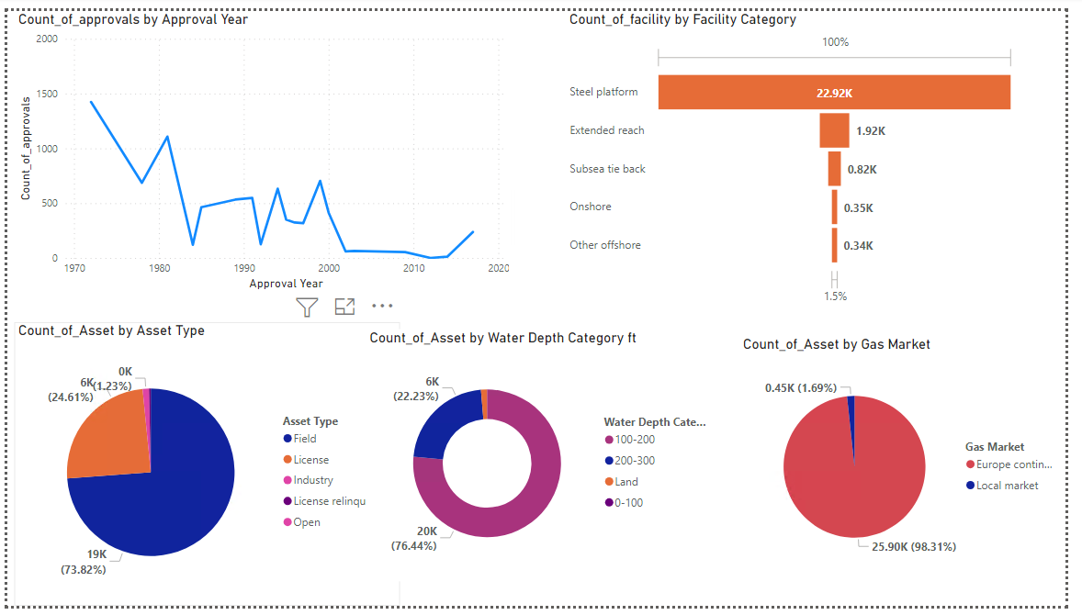

Slide 13
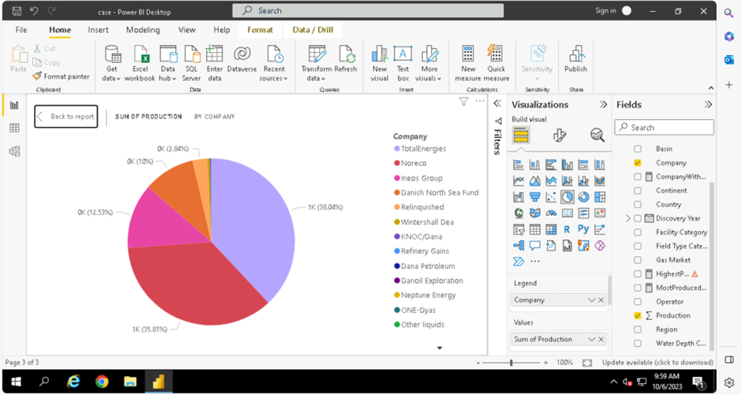

Slide 14
"Which company should one consider investing in by analyzing a dataset of assets generated by various companies over the years?

Slide 15
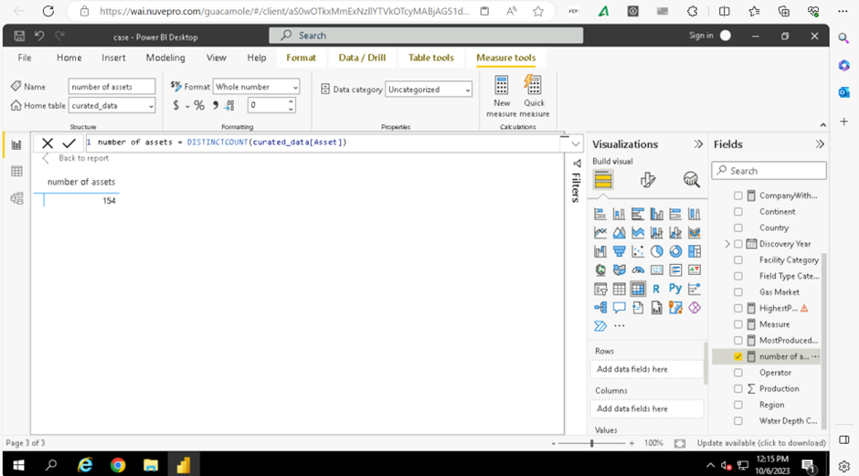

Slide 16
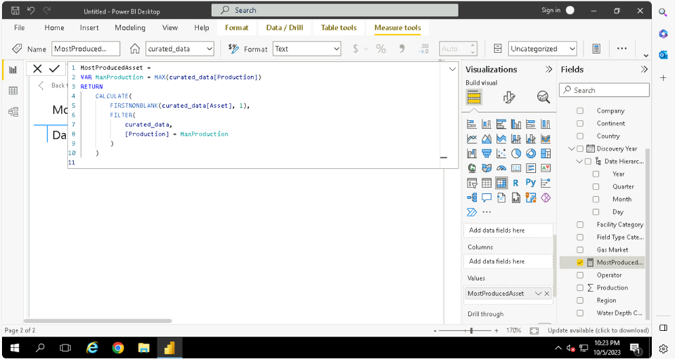

Slide 17
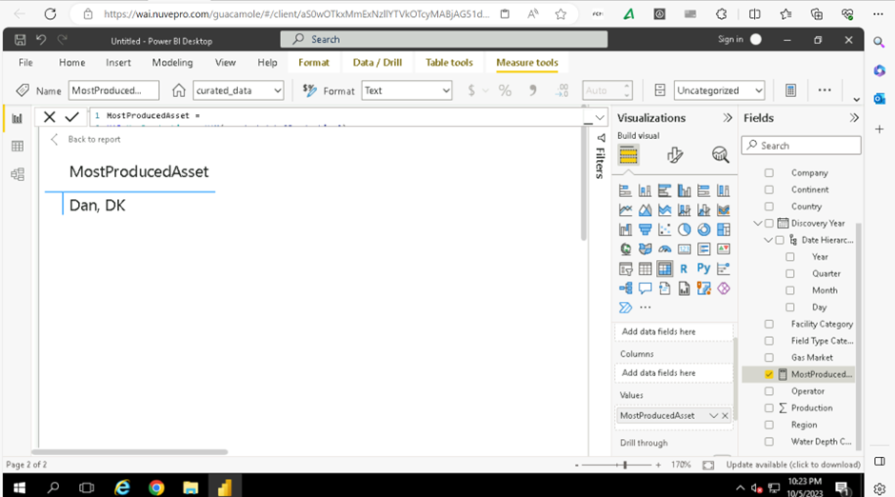

Slide 18
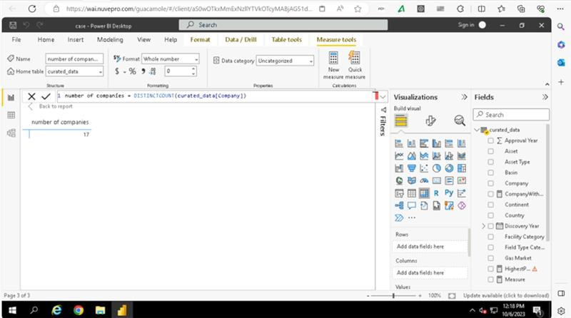

Slide 19
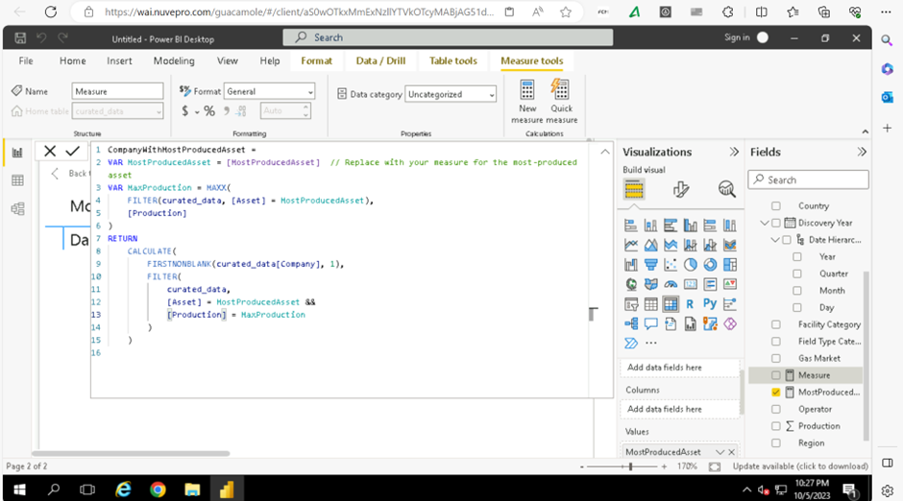

Slide 20
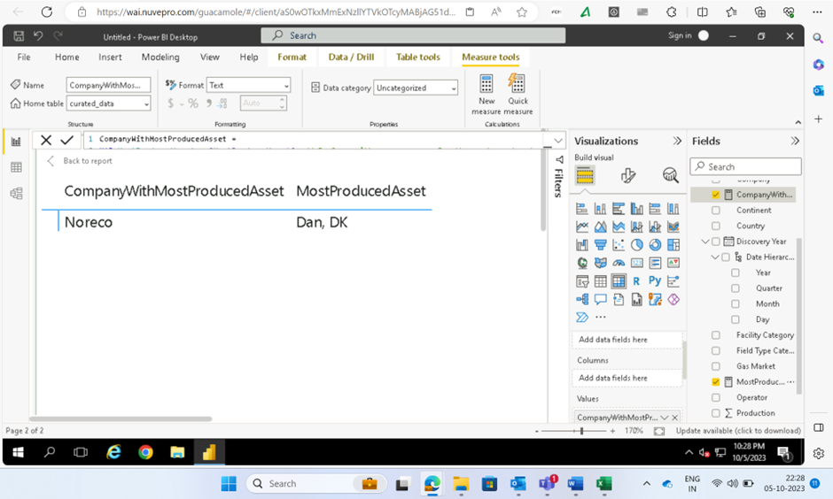

Slide 21
Github link
annikaa05/TeamTBA_CS4 (github.com)

Slide 22

System Demo

Slide 23
Challenges and Learnings
Dataset was vast and varied.
Staging data got stored into partitions.
Column Names had spaces in them
‘\\N’ null key was challenging to deal with in ADF and we had process it in ADF.

Slide 24

Any Questions?
Or are you asleep?

Slide 25
Thank you

